Slide 1
Open Educational Resources (OER) Supporting Access & Affordability for Massachusetts Students
May 1, 2018

Slide 2
Overview: What Are OER?
Open Educational Resources (OER)
“Teaching, learning, and research resources that reside in the public domain or have been released under an intellectual property license that permits their free use and repurposing” (William and Flora Hewlett Foundation)
Creative Commons or General Public License that states how the material may be used, reused, adapted, and shared
Every type of material, from a single video or lesson plan to a complete online course or curriculum

Slide 3
Overview: What Are OER?
Open Educational Resources (OER)
Faculty often curate OER to create course materials or use an open textbook
Copyright permissions on open textbooks allow the public to use, adapt, and distribute high-quality course materials
OER Commons Textbook Hub:
https://www.oercommons.org/hubs/open-textbooks

Slide 4
Overview: Why Support OER?
Open Educational Resources (OER)
Tremendous cost savings to students:
The average cost of college textbooks has risen 4 times faster than the rate of inflation over the past 10 years (Money Watch, January 2018)
Students spend more than $1200 on books and materials each year (College Board)
Students have access to course material on day one
Faculty can customize course materials to fit the needs of their students
High cost of textbooks is negatively impacting student access, success, and completion

Slide 5
Overview: Why Support OER?
Open Educational Resources (OER)
U.S. Public Interest Research Group Education Fund student survey (2013):
65% of students skip buying required texts at some point in their college career due to high cost of textbooks
94% of students who had chosen not to purchase a textbook were concerned that doing so would hurt their grade in the course—yet knowingly accepted the risk of a lower grade to avoid paying for the textbook
48% of students reported that cost of textbooks impacted how many and which classes they took
82% of students felt they would do significantly better in a course if textbook was available free online and buying a print copy was optional

Slide 6
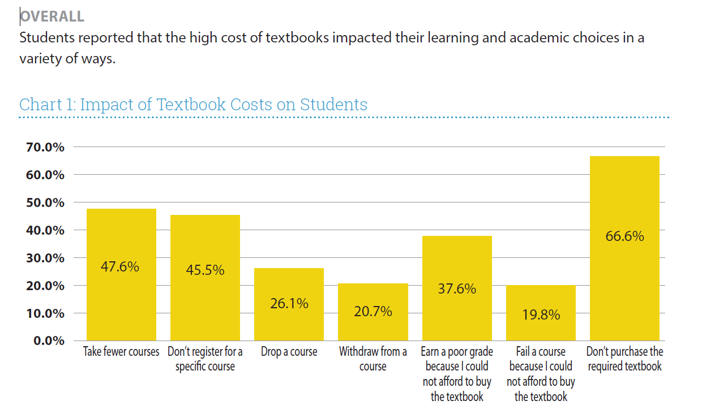
Overview: Why support OER?
Open Educational Resources (OER)
Source: 2016 Student Survey by Florida Virtual Campus

Slide 7
Existing Support for OER: FY18 PIF Grants
Open Educational Resources (OER)
Campus | Grant Focus | Description | Award
Bristol | Expanding pathways to student success | Create OERs to support underprepared students, scale services to directly support adult learners, and develop training programs for faculty and professional advisors on the College’s Proactive Advising model. | $75,000
Greenfield | Creating a technology lending library | Provide crucial technology and OER’s for students with the goal of increasing access to critical educational computing and technology, particularly for low-income students who cannot afford technology for home and/or for off-campus use. | $69,958
Massasoit | Expanding use of OER | Increase number of courses and sections offered using OER from 51 in fall 2017 to 90 in fall 2018, increase number of faculty who teach at least one course using OER from 35 to 65, and reduce student textbook costs by $270,000 for fall 2018 semester. | $58,765
Mount Wachusett | Implement OER faculty fellowship program | Develop and implement OER outreach/PD for a ten Faculty Fellows cohort. The PD includes access to OER resources and exposure to common technology used to make OER adoption more successful. Faculty Fellows then develop a curriculum map of their courses for full OER integration into their courses. | $16,235
North Shore | Flexible learning | Develop 20 hybrid courses to create an accelerated Liberal Arts Transfer degree featuring high impact practices: faculty advising; credit for prior learning; open educational resources (OER) and low cost texts; embedded First Year Experience (FYE) courses; seven-week back-to-back hybrid courses, and structured schedules. | $100,000
TOTAL: |  |  | $319,958

Slide 8
Go Open Project
Massachusetts Community Colleges
Sue Tashjian, Coordinator of Instructional Technology, Northern Essex Community College
Jody Carson, Professor of Early Childhood Education, Northern Essex Community College

Slide 9
Addressing the Issue
Student Forums
#1 Issue - Textbook Use and Costs
Textbook Task Force
Adopt Open Project @ NECC

Slide 10
From Grassroots to Statewide
Massachusetts Community Colleges Go Open!
More courses, more students, more savings!
The GPSTEM project is funded by a $20,000,000 grant awarded by the U.S. Department of Labor’s Employment and Training Administration, Grant # TC-26450-14-60-A-25. This product was created by the grantee and does not necessarily reflect the official position of the U.S. Department of Labor.

Slide 11
MA CC Go Open Project
https://youtu.be/Sj-zPjkYp20

Slide 12
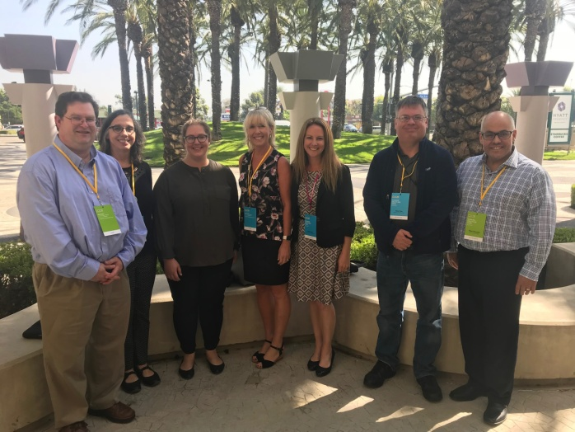
Structure of Project
Mass Community College Open Education Council
Offer statewide and regional trainings
Select OER repository to support MA faculty
Offer Go Open grants to faculty
Build a sustainable model

Slide 13
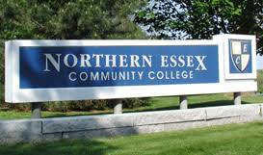
Benefits to Institution
Increased revenue
OER savings allows students to enroll in additional credits
Increased retention
Empirical data shows that OER increases retention
Faculty satisfaction and engagement with course development

Slide 14
Benefits to Faculty
Deeper reflection of course materials
Freedom of content
Richer content
Current course materials
Full course sections
Student Access - Day 1 - Better prepared

Slide 15
Benefits to ALL Students
Cost Savings
Streamlined pathway to graduation
Day-1 Access to course materials
Post-course Access

Slide 16
Lessons Learned/Challenges
MCC network - 15 campuses
Lacking in common course titles and programs
Varying levels of knowledge and experience with OER
Have a more open and flexible timeline
Fluid process - pilot - innovative
Adaptable - embrace the unique philosophies and campus cultures

Slide 17
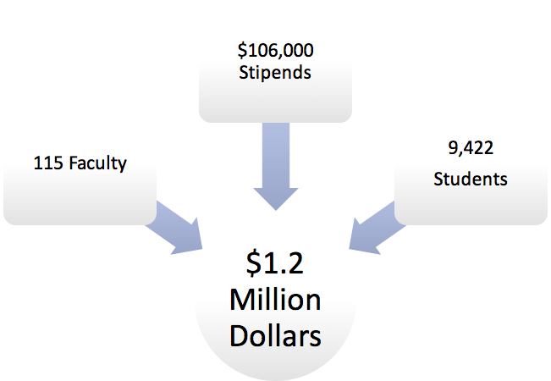
Small Investment = Big Results
First academic year
savings to students!

Slide 18
Northeast Regional OER Summit
Partnered with Lumen Learning
Multi-state collaborative event
New and experienced OER advocates
Share effective practices
260 people attended the two-day conference
You’re all invited!

Slide 19
Student Engagement in OER
Student Advisory Council
Charles Santamaria, SGA President, MassBay Community College; Vice Chair, BHE’s Student Advisory Council

Slide 20
Student Voices
Student Advisory Council FY18 Priority: Open Educational Resources
“Last semester, I dropped a course because I couldn’t afford the required textbooks. With students struggling to cover the costs of tuition and fees alone, OER expansion is an opportunity to help with the hardships students face in paying for college.”
–Marco Cobar, Chair, DHE Student Advisory Council, testifying at DHE’s legislative briefing on College Access & Affordability, April 4, 2018

Slide 21
Timeline
Student Advisory Council FY18 Priority: Open Educational Resources
SAC Creates FY18 Action Plan for OER
OER Campus Status Updates
SAC Approves Resolution on OER
October | December | January | February | March | April
SAC Identifies OER as an FY18 Priority
Presentation on OER at Mid-Year Retreat
SAC Drafts Resolution on OER

Slide 22
Discussion
Open Educational Resources (OER)

